Slide 1
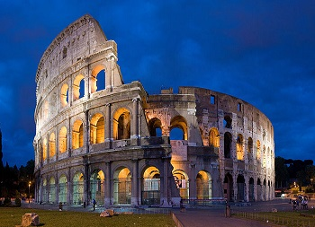
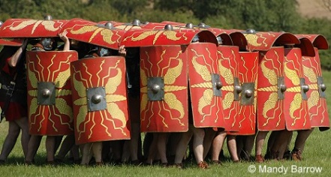
HOME LEARNING MENU
Year 3 – Term 5
Complete one main each week, a challenge once a term and a starter when you're feeling 'home learning hungry‘. Complete one task every week. Tick off each task that you do.
Starter
Write the blurb for the book you are reading at the moment. Using your sketching skills, sketch a picture of a Roman Legionnaire. Find out the different events that happened at the Colosseum. Draw a map of Italy. Use colours and pictures to make it interesting!
Main
Make a Roman Gladius (sword). Write a biography of a Roman Emperor. Write instructions on how to wear a toga. Draw a comic strip of a Roman myth or legend. Write a poem about the Romans. | Research a Roman battle and explain what happened. Use diagrams to help. Design a poster to recruit somebody to the Roman army. Find out what the Romans did for us. Design your own Roman shield. | Research Roman history in the Bristol area. CLUE: Bath is a good place to look! Write some maths word problems using Romans as a theme. Draw a picture of a Roman building. Try to make it as accurate as possible. Write a diary as if you were a child during the Roman period.
Challenge!
Create a story set in the Roman period. Go to the library or visit a Roman historical site – Caerleon and Bath are great! Make a Roman Meal and write down your recipe. Make the Colosseum or another Roman building.

